Slide 1

Doctrine 2 tutorial
Juozas “Joe” Kaziukėnas
http://juokaz.com / juozas@juokaz.com / @juokaz

Slide 2

Who is this guy?
Juozas Kaziukėnas, Lithuanian
You can call me Joe
3 years in Edinburgh, UK
CEO of Web Species Ltd
Occasional open source developer
Conferences speaker
More info in http://juokaz.com
Tweet me @juokaz

Slide 3
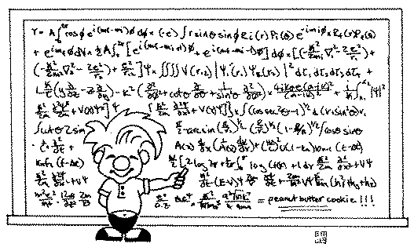
This tutorial is about
What are ORMs
If you were a user of Doctrine 1.X…
What Doctrine 2 can do / what’s new
Doctrine 2 basics
Creating entities
Creating database structure
Updating database structure
Saving entities
Relations
Getting entities back
Querying
Updating entities
Repositories
Events
Performance
Migration
Conclusions

Slide 4

What are ORMS?

Slide 5
They solve
“old-style” PHP
SQL everywhere
Hard to understand
No migrations possible
Not OOP
At least not for database interactions

Slide 6
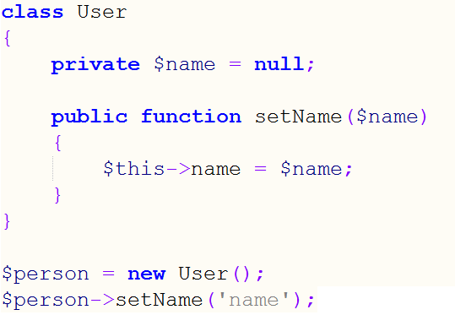
You should know this

Slide 7
What are ORMs?
Object-relational mapping in computer software is a programming technique for converting data between incompatible type systems in object-oriented programming languages. This creates, in effect, a "virtual object database" that can be used from within the programming language. There are both free and commercial packages available that perform object-relational mapping, although some programmers opt to create their own ORM tools.

Slide 8
What are ORMs?
Usually map data from database to objects
Database row === entity instance
Table === entity specification
Objects are awesome, things you learned in OOP 101
Also map relations
Handle types conversions
Data handling functionality on top
Additional functions
Part of good design
Part of Domain model

Slide 9
What are ORMs?
Awesome! But…

Slide 10
Awesome! But…
Doesn’t work in all cases
If you are building a Facebook
Adds overhead
Impossible to avoid
Requires very good OOP understanding
Some people just hate it

Slide 11
Frameworks vs From scratch
Your project might end here

Slide 12

Let’s start

Slide 13
Before we start
Live coding, can go wrong
Putting all code into slides just didn’t make sense
Models are part of MVC, not necessary part of ORM
Doctrine 2 calls them Entities
ORM do not relate to databases
They can map data and relations from anything
XML anyone?

Slide 14

If you were a user of Doctrine 1.X…

Slide 15
If you were a user of Doctrine 1.X
Doctrine 2 is going to blow you away
No more Behaviours
No more ActiveRecord
$record->save();
No more slowness
Migrating to Doctrine 2

Slide 16

What Doctrine 2 can do / what’s new

Slide 17
What Doctrine 2 can do / what’s new
PHP 5.3
EntityManager
DataMapper
Plain PHP objects
Components
Common
DBAL
ORM
ODM
Optimizations
Performance

Slide 18

Doctrine 2 basics

Slide 19
Doctrine 2 Basics
Autoloading
Entity Manager
Configuration
Console
A must use tool

Slide 20

Creating entities

Slide 21
Creating entities
Classes
Do not extend anything
DataMapper pattern
Relay heavily on mapping information
Mapping can be done in (switchable)
XML
PHP
YAML
Annotations
Auto from database
doctrine orm:convert-mapping --from-database yml

Slide 22
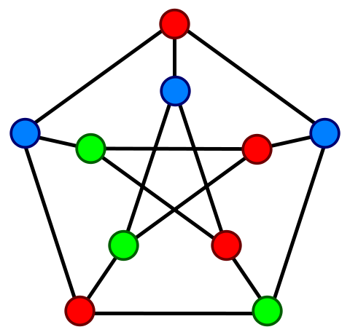
Creating database structure

Slide 23
Creating database structure
SchemaTool
Using Console tool
SQL from Entities metadata
Executed for targeted platform
Same metada for any DB server, any host

Slide 24

Updating database structure

Slide 25
Updating database structure
Compare configuration to database schema
Diff executes as SQL
Migrations
Separate tool (alpha)
Generate: doctrine migrations:diff
Update: doctrine migrations:migrate

Slide 26
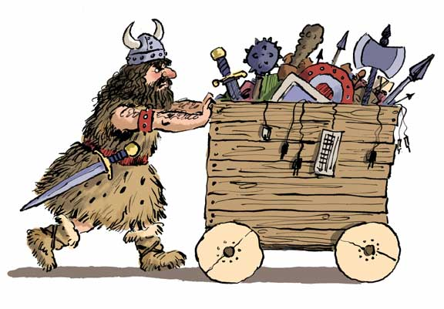
Saving entities

Slide 27
Saving entities
Create entity instance
Using EntityManager
Persists($obj)
Flush()
Merges multiple changes
For speed

Slide 28

Relations

Slide 29
Relations
Different types
One-to-One
Many-to-One
One-to-Many
Many-to-Many
Different directions
Cascade
cascade={"persist", "remove"}
orphanRemoval=true

Slide 30

Getting entities back

Slide 31
Getting entities back
Multiple ways
Here - find by primary key
Entity inside
Constructor usage
ArrayCollection for arrays
Locking
Querying

Slide 32

Querying

Slide 33
Querying
DQL language, similar to SQL
Queries as
Strings
QueryBuilder
Lazy Loading
Native Queries

Slide 34

Updating entities

Slide 35
Updating entities
An entity is needed
Or update query
UPDATE User u SET u.password = 'new' WHERE u.id = 1
Entities become dirty
UnitOfWork
Differences are saved In DB

Slide 36

Repositories

Slide 37
Repositories
Entities’ handler for specific type
Find
Query
Custom repository
@Entity(repositoryClass="Repositories\UserRepository")

Slide 38

Events

Slide 39
Events
Happen after and before
Persist
Remove
Update
Flush
Load
Entities can react
@HasLifecycleCallbacks
Connect to events manager
Do not overuse
Creates overhead

Slide 40
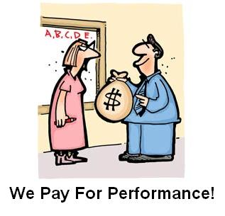
Performance

Slide 41
Performance
Query logging
Different hydrations
Record is default
Array is easy to switch to
Scalar is RAW
Batch processing and iterations
Too deep relations
Lazy-loading overuse
Cache (a must!)
Metadata
Results
Query
Transactions matter
More http://www.doctrine-project.org/docs/orm/2.0/en/reference/best-practices.html

Slide 42

Migration

Slide 43
Migration
Schema migration from D1 to D2
Ohh can be tricky!!!
Is it even worth?
Migrating over applications
DBAL first
Then if MVC – to Entities
If not – probably not worth it
Eventual use of functionality

Slide 44
Conclusion

Slide 45
Conclusion
Doctrine 2 is a very powerful piece of software
All functionality is built around making easier to work with Domain Layer
Saving / Updating / Fetching / Deleting Entities
Support a lot of different behaviors
Performance requires tricks

Slide 46
Thanks!
Keep in touch
http://juokaz.com
juozas@juokaz.com
twitter: @juokaz
Ask for slides and code examples
Leave feedback http://joind.in/3755

